Slide 1
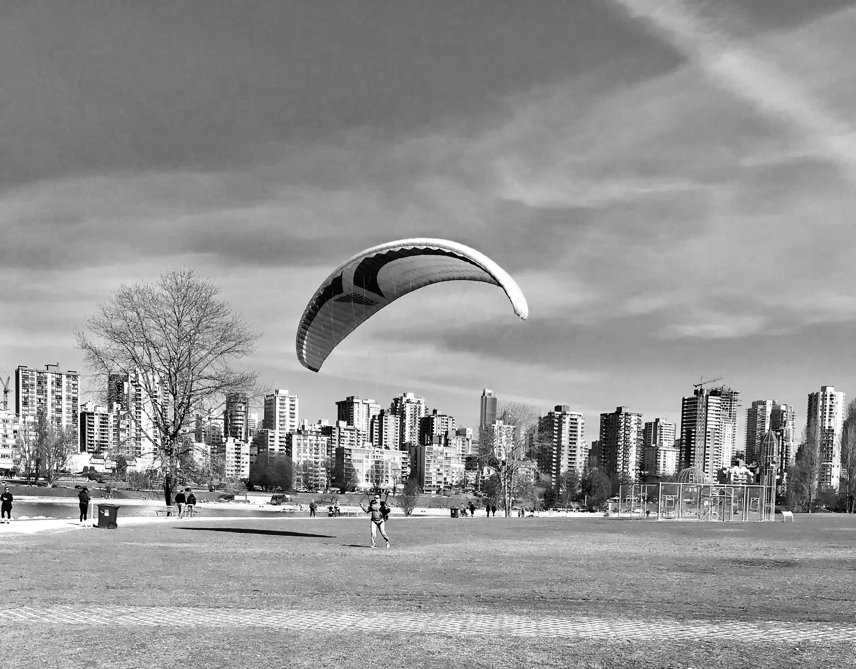
ANet
The most important thing is to enjoy your life.
It’s all that matters.
Created by an

